Slide 1
Main Memory & Virtual Memory on Windows 10
Hilman Maulana Anhar
Muhamad Dani Setiawan
1SC8

Slide 2

What is windows 10 ?

Slide 3
What is Main Memory & Virtual Memory ?

Slide 4

Main Memory On Windows 10
SRAM
RAM
DRAM
Type of Memory
PROM
ROM
EPROM
EEPROM

Slide 5
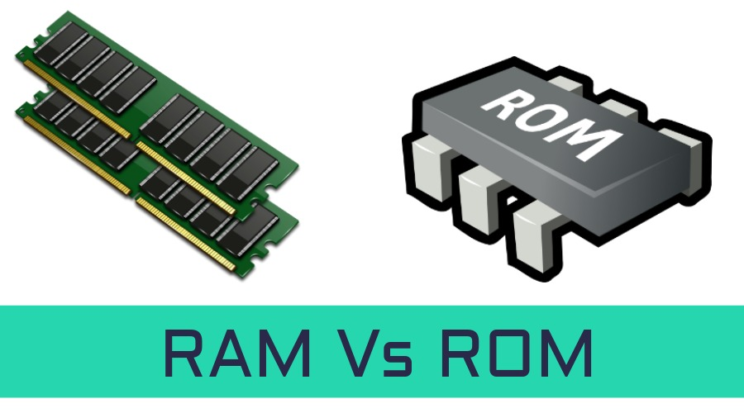
Difference Between RAM and ROM
RAM | ROM
Temporary Storage | Permanent Storage
Store Data in MBs | Store Data in GBs
Volatile | Non Volatile
Used in Normal Operations | Used for Startup Process of Computer
Writing Data is Faster | Writing Data is Slower

Slide 6
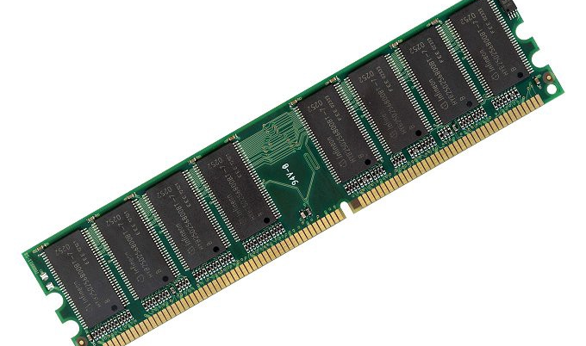
Difference Between DRAM and SRAM
RAM ( RANDOM ACCES MEMORY )
DYNAMIC RANDOM ACCESS MEMORY | STATIC RANDOM ACCESS MEMORY
Constructed of tiny capacitors that leak electricity | Constructed of circuits smilar to D flip-flops
Requires a recharge every few milliseconnds to maintains its data | Hold its contents as long as power is available
Inexpensive | Expensive
Slower than SRAM | Faster than DRAM
Can store many bits per chip | Can not store many bits per chip
Uses less power | Uses more power
Generates less heat | Generates more heat
Used for main memory | Used for cache

Slide 7
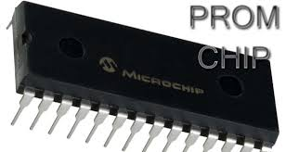
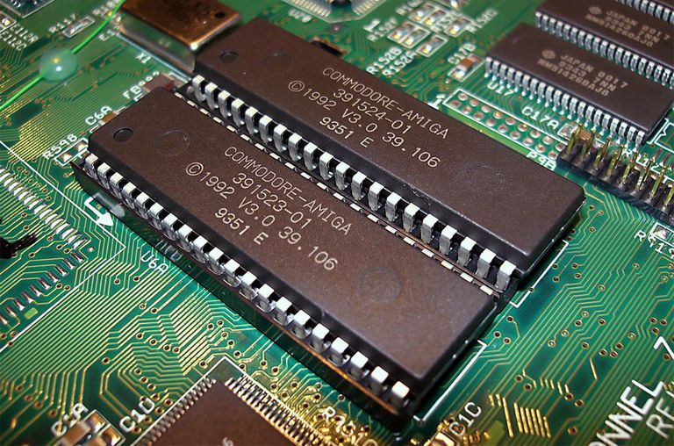
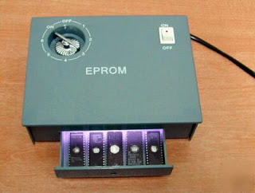
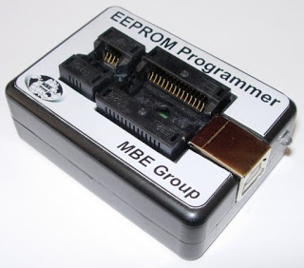
Type of ROM (Read Only Memory)
ROM ( Read Only Memory)
PROM (Programmable
read-only memory)
EPROM
(Erasable Programmable read only memory)
EEPROM (Electrically erasable programmable read only memory)

Slide 8
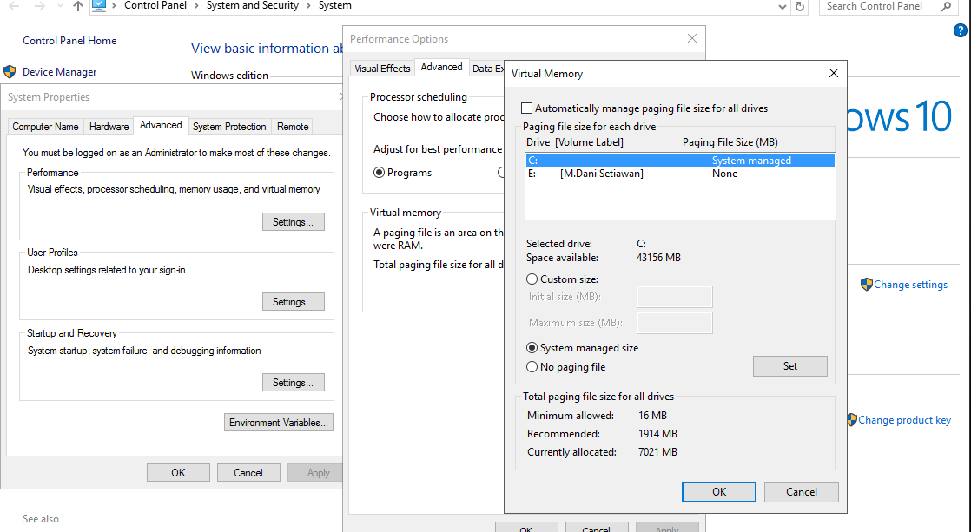
How to Manage Virtual Memory on Windows 10 ?

Slide 9
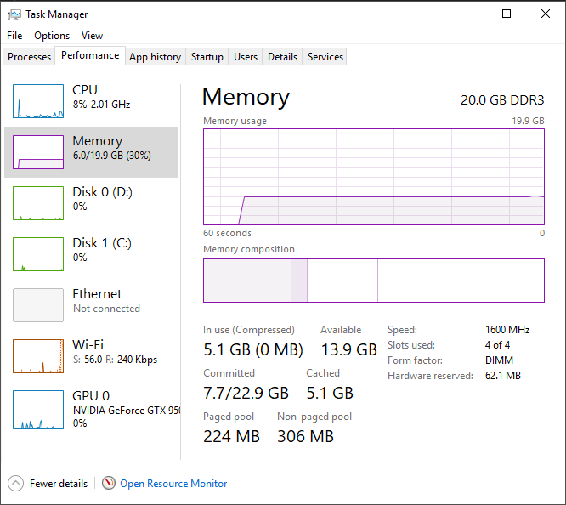
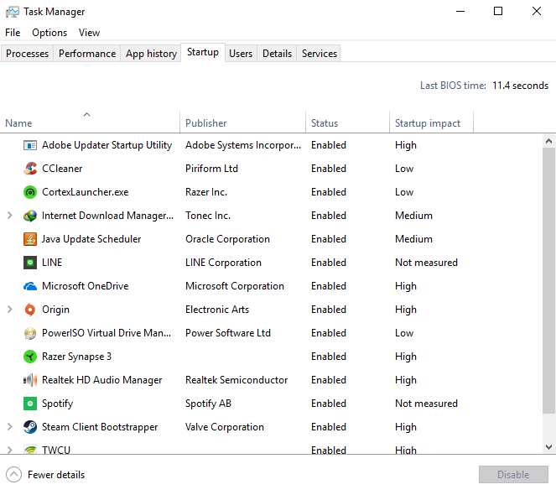
Memory Management on Windows 10
HOW TO CHECK MEMORY USAGE ON WINDOWS 10
HOW TO REDUCE HIGH MEMORY USAGE ON WINDOWS 10

Slide 10
THANK YOU FOR ATTENTION
ANY QUESTIONS? ☺

